Slide 1
FIT1047 Week 1 Forum
Introduction to Computer Systems, Networks and Security

Slide 2
Learning Outcomes
At the end of this workshop, you will be able to:
1. Describe basics of computer systems
2. Convert numbers in different bases
3. Represent negative numbers in binary form
4. Represent of numbers using Floating Point
5. Represent text using ASCII Code
6. Understand operations of basic gates

Slide 3
Forum
Activity 1: Kahoot – introduction to computer system and number conversion (30 minutes)
Activity 2: Discussion - negative number representation (20 minutes)
Activity 3: Demo - floating point representation (20 minutes)
Activity 4: Group discussion – text representation (20 minutes)
Activity 5: Demo - Logisim (AND, OR, NOT gates) (20 minutes)

Slide 4

Activity 1: Introduction to Computer System and Number Conversion
Please use your mobile phone
Open Chrome app and go to Kahoot.it
Key in the Kahoot code to join
Please use your nick name
Play the game
There are 10 questions in the Kahoot quiz, we will go through question by question together with detailed discussions.
You should be able to achieve LO1 and LO2 at the end of quiz and discussion.
The quiz questions and answers (pdf format) will be uploaded to the Moodle for your post-forum reference.

Slide 5
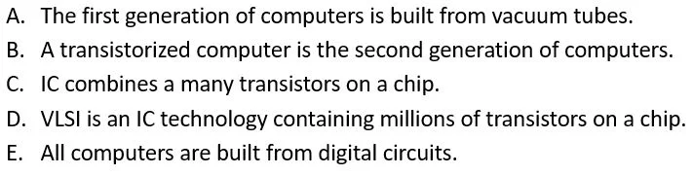
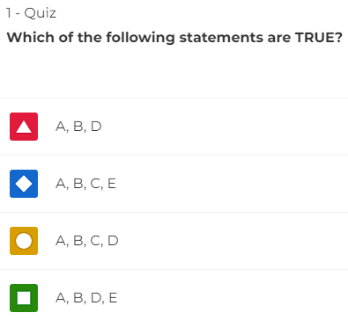

Slide 6
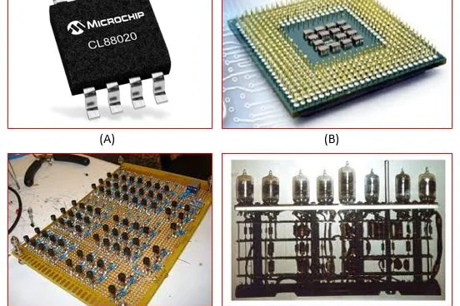
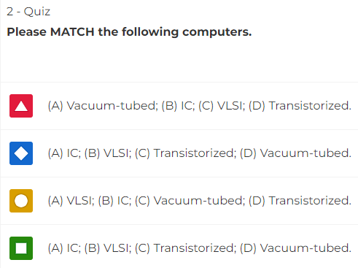

Slide 7
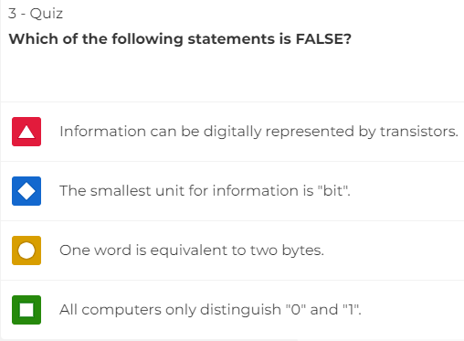

Slide 8
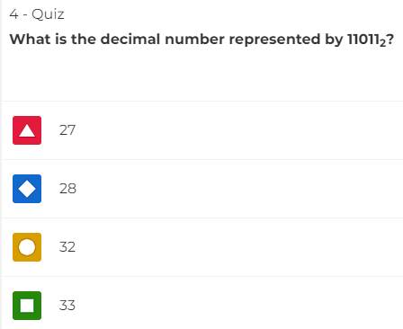

Slide 9
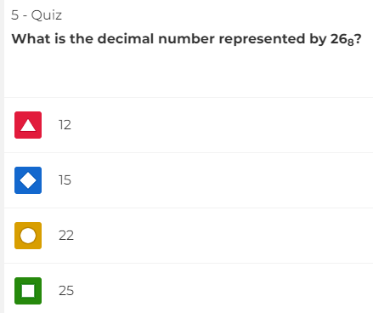

Slide 10
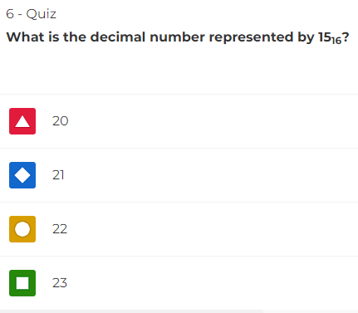

Slide 11
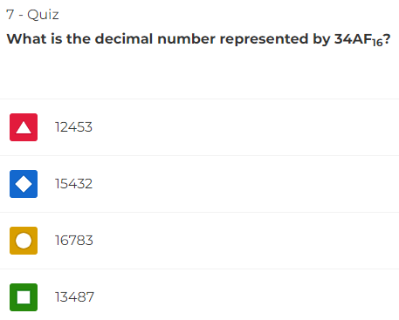

Slide 12
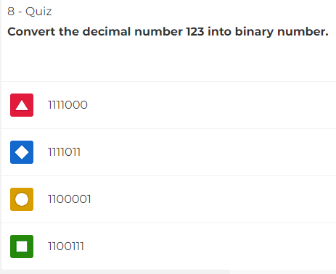

Slide 13
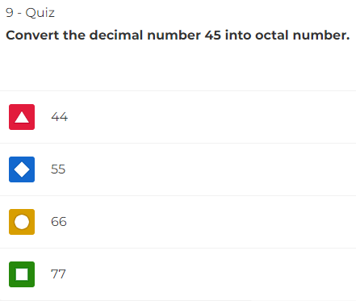

Slide 14
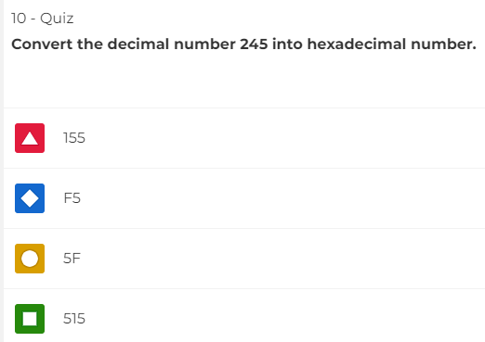

Slide 15
Activity 1: Introduction to Computer System and Number Conversion (Self-Attempt)
1. Convert decimal number 25.25₁₀ into its corresponding binary number.
2. Convert binary number 10.011₂ into its corresponding decimal number.
Answers will be provided in the Moodle forum on Friday.

Slide 16

Activity 2: Negative Number Representation
There are 4 problems, you will be given some time to attempt them and the solutions together with the working steps will be provided.
You should be able to achieve LO3 at the end of this discussion.
The annotated file will be uploaded to the Moodle site after the forum for your reference.

Slide 17
Activity 2: Negative Number Representation
1. Represent -45 using 7-bit signed magnitude, 1’s complement and 2’s complement.
2. Represent -70 using 8-bit signed magnitude, 1’s complement and 2’s complement.

Slide 18
Activity 2: Negative Number Representation
3. Find the decimal value for the binary number 1011010₂ in unsigned binary, sign-magnitude, 1’s complement and 2’s complement. Assume that this is a 7-bit binary system.
4. Find the decimal value for the binary number 01110110₂ in unsigned binary, sign-magnitude, 1’s complement and 2’s complement. Assume that this is a 8-bit binary system

Slide 19

Activity 3: Floating Points
A clear demonstration of representation using floating point will be shown.
A proper walk-through of all converting steps from decimal number to floating points will be provided.
You should be able to achieve LO4 at the end of this demonstration.
The annotated file will be uploaded to the Moodle site after the forum for your reference

Slide 20
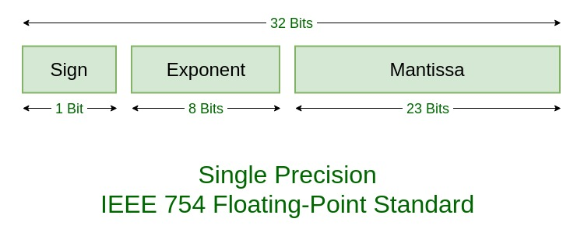
Activity 3: Floating Points
Converting 24.35 into a 32-bit floating point

Slide 21
Activity 3: Floating Points
Converting 24.35 into a 32-bit floating point

Slide 22
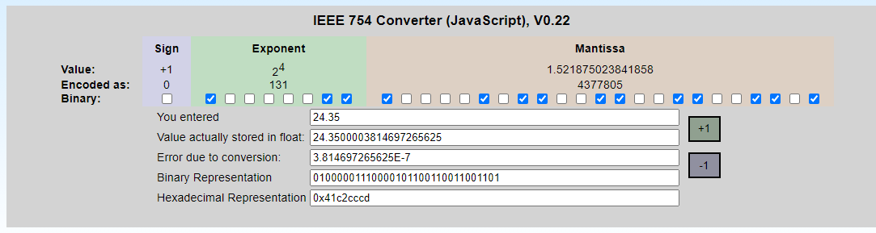
Activity 3: Floating Points
Converting 24.35 into a 32-bit floating point
https://www.h-schmidt.net/FloatConverter/IEEE754.html

Slide 23
Activity 3: Floating Points (Self-Attempt)
Converting the following 32-bit floating point to a base 10 scientific notation.
1 01111101 10110000000000000000000
Answers will be provided in the Moodle forum on Friday.

Slide 24

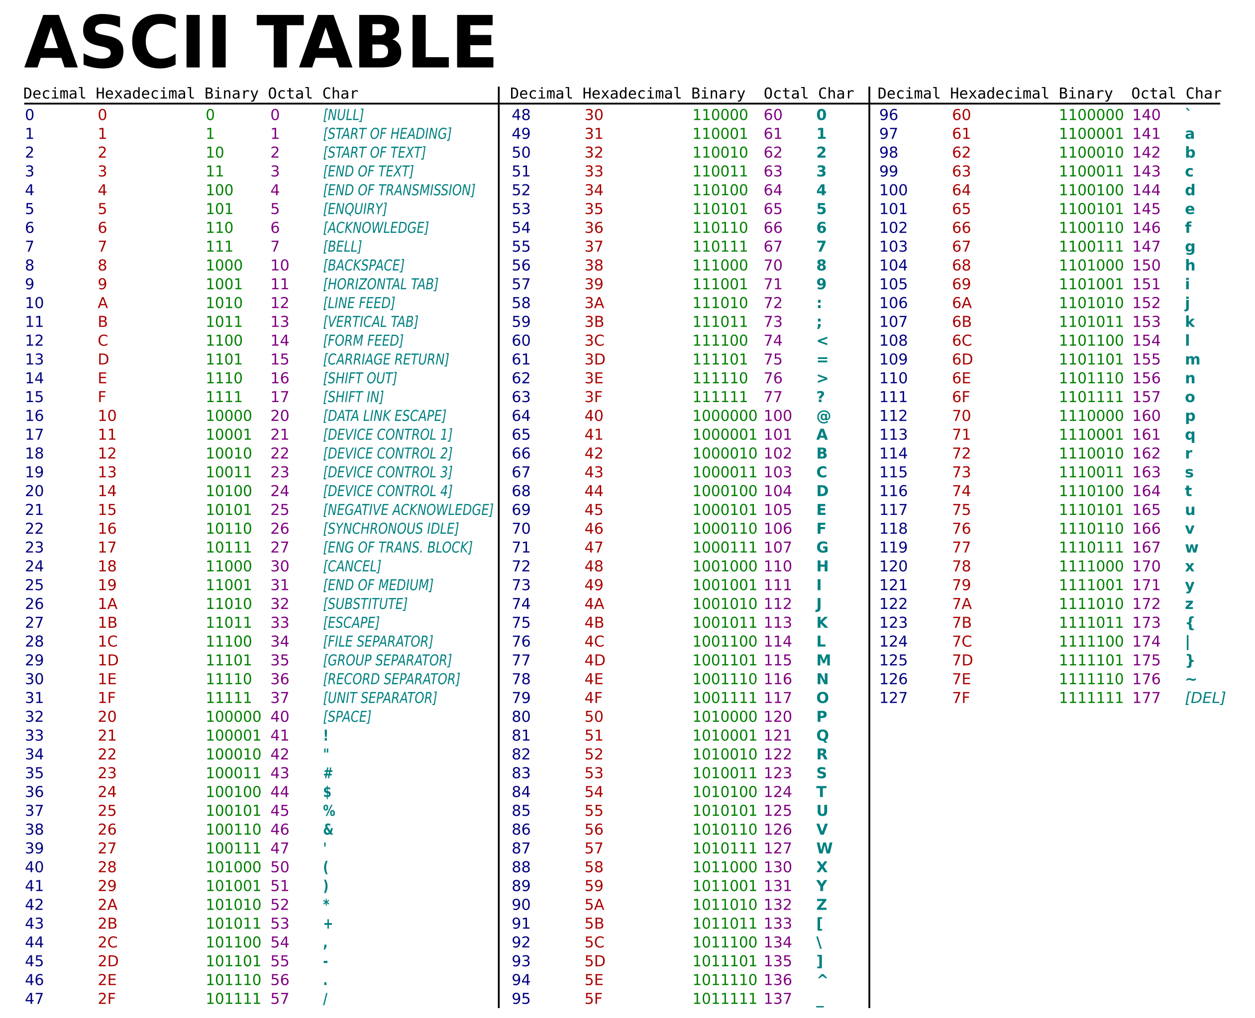
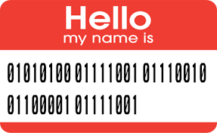
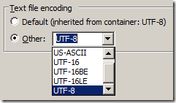
Activity 4: Text Representation
You will be divided randomly into breakout room of 4, please shortly introduce yourselves.
Use the link provided, watch a 3-minute video.
Work together with your friends to solve the questions.
Answers will be provided once you come back from the breakout rooms.
You should be able to achieve LO5 at the end of this group discussion.

Slide 25

Activity 4: Text Representation
Watch the videos using the link provided.
Search online to find a 7-bit ASCII table and an 8-bit ASCII table.
Using the table, solve the conversion problem below:
1. Convert the following text to ASCII code using 7-bit ASCII table:
Hi All!
2. Find the text for the following ASCII code using extended ASCII table:
01000110 01001001 01010100 00110001 00110000 00110100 00110111
https://www.youtube.com/watch?v=9NKcgp8KH2k

Slide 26
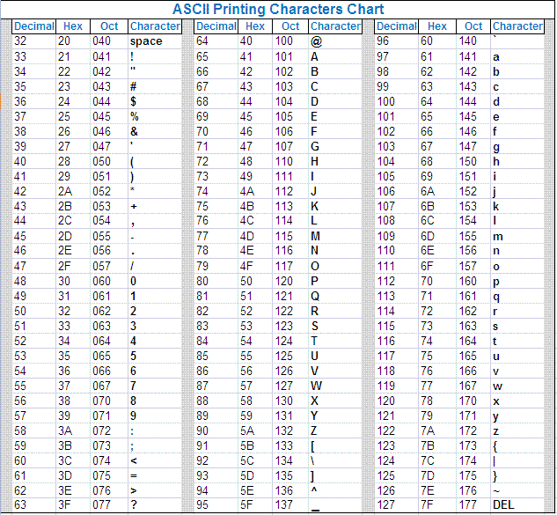
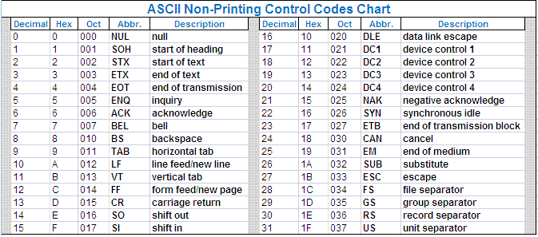
Activity 4: Text Representation (Appendix)

Slide 27
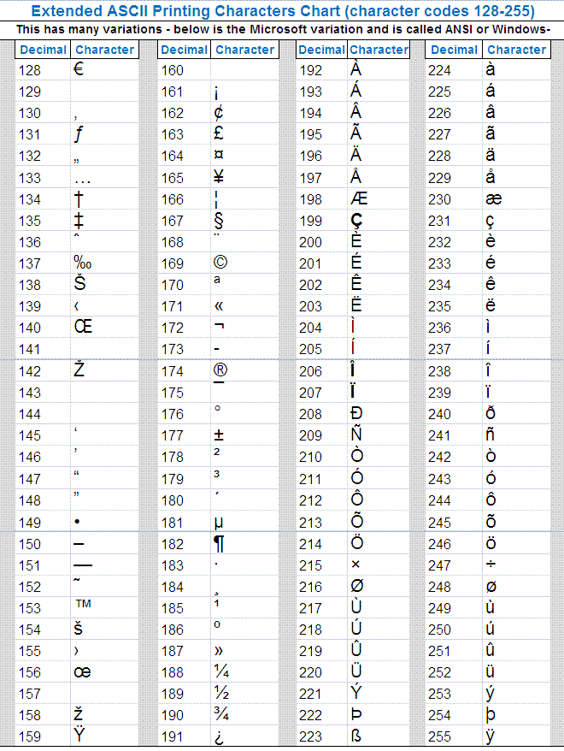
Activity 4: Text Representation (Appendix)

Slide 28
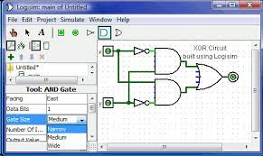
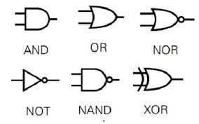
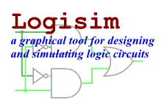
Activity 5: Operation of Basic Gates
Please download the Logisim software from Moodle Week 1 (under the Forum section).
You will be guided to open the software on your machine.
A demonstration will be provided to show you how to get the truth tables for AND, OR, NOT gates.
Attempt the given problems.
You should be able to achieve LO6 at the end of this discussion.

Slide 29
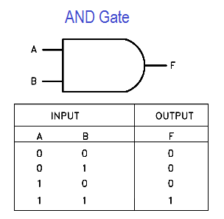
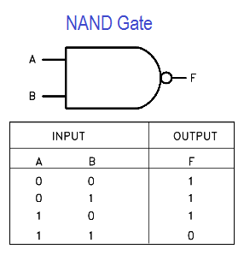
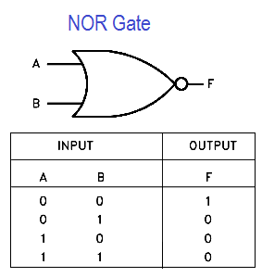
Activity 5: Operation of Basic Gates
Problem 1: Use the Logisim to construct the truth tables of the OR and NOT gates.
Problem 2: Build a circuit using AND + NOT to get a NAND.
Problem 3: Build a circuit using OR + NOT to get a NOR.

Slide 30


